Slide 1


Objectives
In this session, you will learn to:
  Enhance tables
  Access multiple Web pages by using frames

Slide 2
Enhancing Tables
  CSS provides the following properties to enhance the visual appearance of a table:
padding
border
border-collapse
text-align
color
height
background-color
width

Slide 3
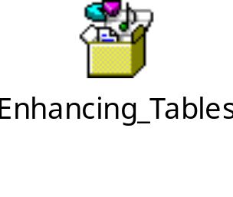
Enhancing Tables (Contd.)
  The following embedded Notepad file contains the code to create a table and enhance its appearance using CSS:

Slide 4
Enhancing Tables (Contd.)
Use the animation, HTML_03_Enhancing_Tables.swf, to understand the impact of CSS for enhancing the visual appearance of the tables.
Use the animation, HTML_03_Creating_and_Enhancing_Tables.swf, to understand the creation and styling of tables.

Slide 5
Just a Minute
Which one of the following CSS properties is used to set the color of the border
and text in a table?
  color
  background-color
  border-color
  text-color

Slide 6
Just a Minute (Contd.)
Solution:
  color

Slide 7
Demo: Creating a Table
Problem Statement:
  ShowOnWheels wants to add the details and the show timings of the movies to be screened in the upcoming months on the website. This will help the customers in booking the shows of their choice. Steve is a Web developer with WebCreator Inc. He has been assigned this task. The Web page should incorporate the following features:
    It should display the details of the movies in a tabular format.
    The table should have the following columns:
      Movie Category
      Movie Title
      Starring
      Director
      Release Date
      Certificate
      Online Bookings
    More than one movie can belong to a particular movie category.
    The Starring column should contain some space to display three starring names.
    The Web page should have a heading as Upcoming Movies.
    The table should have a border in the dark green color.
    The background of the table headings should be dark green.
    The text color of rows should be dark green.
  Prerequisite: You need to use the solution of ShowOnWheels that you have created in Activity 2.2 to perform this activity. Ask your faculty to provide you the same.

Slide 8
Demo: Creating a Table (Contd.)
Solution:
  To create a table on a Web page, you need to perform the following tasks:
    1. Create a table.
    2. Apply internal styles.
    3. View the home page.

Slide 9
Accessing Multiple Web Pages Using Frames
A frame is a rectangular region in a browser window that is used to display a
Web page.
The use of frames allow multiple Web pages to be displayed in the same
browser window.

Slide 10
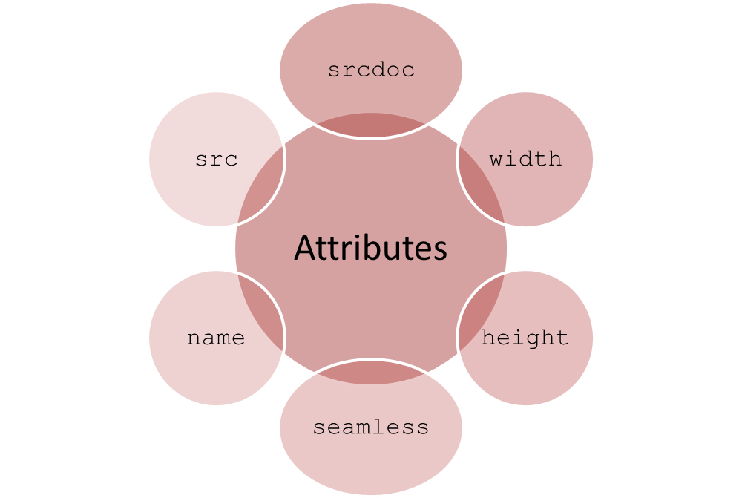
Creating Web Pages Using Frames
The <IFRAME> tag:
  Is used to specify an inline frame.
  Allows you to divide a Web page into sections or frames.
  Has the following attributes:

Slide 11

Creating Web Pages Using Frames (Contd.)
  The following embedded Notepad file contains the code to divide the Home.html page into frames:
Use the animation, HTML_03_Frames_in_HTML.swf,
to understand the concept of frames.

Slide 12
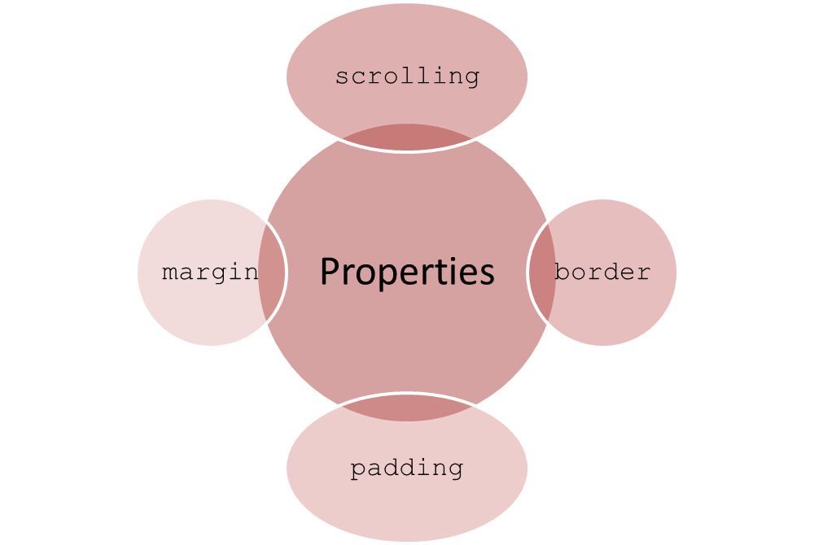
Styling Frames
Frames can be enhanced for a better look and feel using the following CSS
properties:

Slide 13
Just a Minute
Identify the boolean attribute that instructs the browser to display the
frame as a part of the containing Web page.
  seamless
  height
  width
  frameborder

Slide 14
Just a Minute (Contd.)
Solution:
  seamless

Slide 15
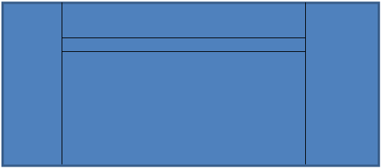
Demo: Accessing Multiple Web Pages Using Frames
Problem Statement:
  ShowOnWheels wants the home page to be modified in such a way that once a user clicks a link, the corresponding Web page should be displayed in a section of the home page. Therefore, all the pages should be displayed in a single window. Steve has been asked to implement this functionality. The home page should be divided according to the structure shown in the following figure.

Slide 16
Demo: Accessing Multiple Web Pages Using Frames (Contd.)
  The following guidelines need to be followed while designing the home page:
    The sections should not display any border.
    The header section should display the name and logo of the company.
    There should be a separate section for the navigation links.
    When the user clicks any link, the corresponding page should be displayed in a section of the home page.
  Prerequisite: You need to use the solution of ShowOnWheels that you have created in Activity 3.1 to perform this activity. Ask your faculty to provide you the same.

Slide 17
Demo: Accessing Multiple Web Pages Using Frames (Contd.)
Solution:
  To divide a Web page into different sections, you need to perform the following tasks:
    1. Create frames.
    2. Create the logo.html file.
    3. Create the nav.html file.
    4. Create the background.html file.
    5. Update the home.html file.
    6. Update the aboutus.html file.
    7. Update the contactus.html file.
    8. Update the upcomingmovies.html file.
    9. Update the homestylesheet.css file.
    10. View the main frame.

Slide 18
Summary
In this session, you learned that:
  CSS provides the following properties to enhance the visual appearance of a table:
    padding
    text-align
    width
    height
    border
    border-collapse
    color
    background-color
  The HTML <IFRAME> tag is used to specify an inline frame. It allows you to divide a Web page into sections or frames.
  Frames can be enhanced for a better look and feel using the following CSS
  properties:
    scrolling
    margin
    border
    padding

